Slide 1
Lab - Response Caching

Slide 2
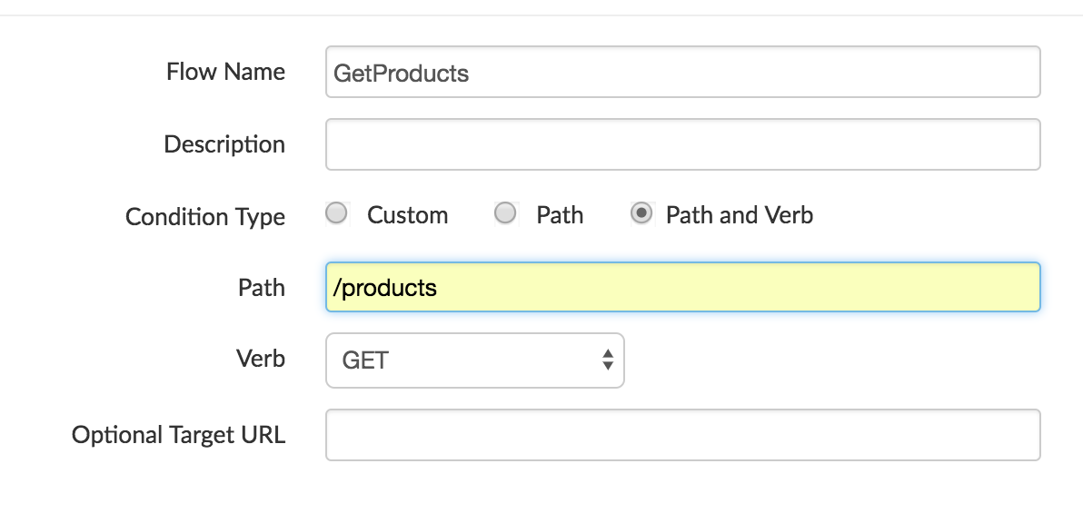
Create a GET /products or Conditional flow
Create a new GET resource in the
Proxy Endpoint
Condition Type:
path and verb
Verb: GET --
Path: /products

Slide 3
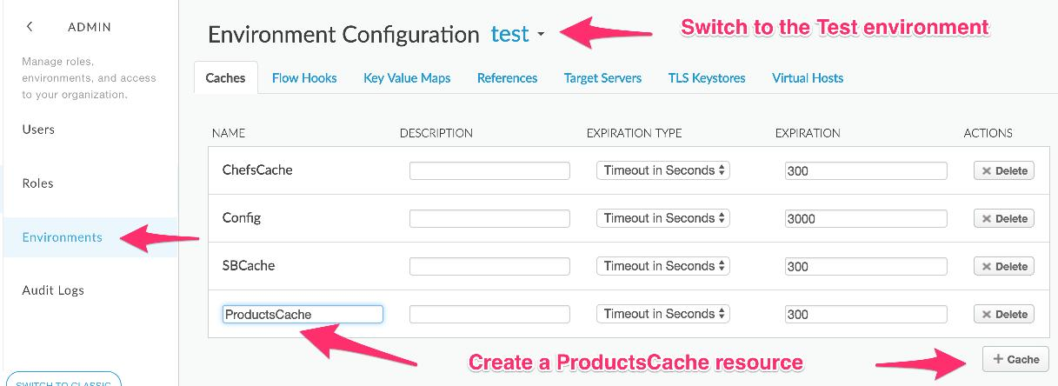
Configure a CacheResource
Add and Configure a response cache policy

Slide 4
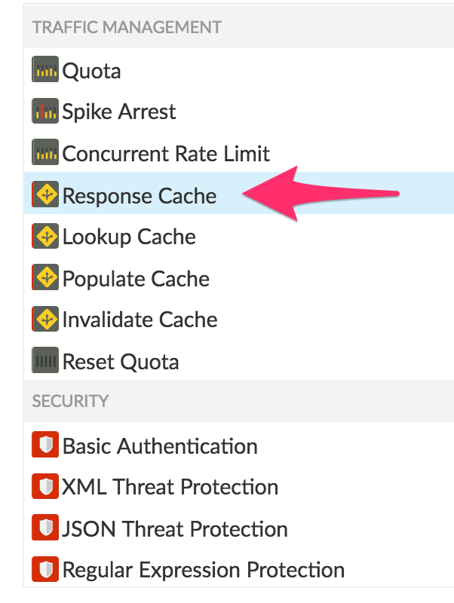
Add a ResponseCache policy
Click the Add Policies button
Add the ResponseCache policy to the /products request and response flows

Slide 5
ResponseCache policy
Add the CacheResource element to the policy identifying the Cache
<?xml version="1.0" encoding="UTF-8" standalone="yes"?>
<ResponseCache async="false" continueOnError="false" enabled="true" name="ResponseCacheProducts">
<DisplayName>ResponseCacheProducts</DisplayName>
<Properties/>
<CacheResource>ProductsCache</CacheResource>
<CacheKey>
<Prefix/>
<KeyFragment ref="request.uri" type="string"/>
</CacheKey>
<Scope>Exclusive</Scope>
<ExpirySettings>
<ExpiryDate/>
<TimeOfDay/>
<TimeoutInSec ref="">3600</TimeoutInSec>
</ExpirySettings>
<SkipCacheLookup/>
<SkipCachePopulation/>
</ResponseCache>

Slide 6
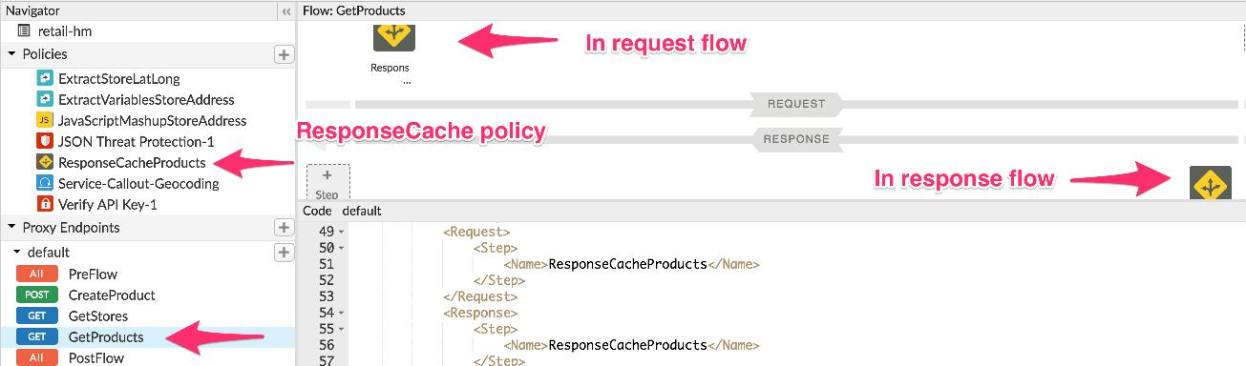
Add the ResponseCache policy to GET /products flow
Response cache policy must be in both the Request and Response of the GET /products flow of the proxy

Slide 7
Test
Invoke the GET /products request and note the response time of the request
Invoke the same request a second time and now notice the response time with the cached response
Clear the cache
Repeat the above tests

Slide 8
THANK YOU

